Slide 1
Hashing

Slide 2
What Is Hashing?
Hashing is a technique for performing almost constant time in case of insertion, deletion and find operation.
Hashing is a technique that is used to uniquely identify a specific object from a group of similar objects.
Mapping key must be simple to compute and must help in identifying the associated records.

Slide 3
Need Of Hashing
Hashing is the process of mapping large amount of data item to a smaller table with the help of a hashing function.
The essence of hashing is to facilitate the next level searching method when compared with the linear or binary search.
The advantage of this searching method is its efficiency to hand vast amount of data items in a given collection (i.e. collection size).
Due to this hashing process, the result is a Hash data structure that can store or retrieve data items in an average time disregard to the collection size.

Slide 4
Suppose we want to design a system for storing employee records keyed using phone numbers.
And we want following queries to be performed efficiently:
Insert a phone number and corresponding information.
Search a phone number and fetch the information.
Delete a phone number and related information.

Slide 5
We can think of using the following data structures to maintain information about different phone numbers.
Array of phone numbers and records.
Linked List of phone numbers and records.
Balanced binary search tree with phone numbers as keys.
Direct Access Table.

Slide 6
For arrays and linked lists, we need to search in a linear fashion, which can be costly in practice. If we use arrays and keep the data sorted, then a phone number can be searched in O(Log n) time using Binary Search, but insert and delete operations become costly as we have to maintain sorted order.
With balanced binary search tree, we get moderate search, insert and delete times. All of these operations can be guaranteed to be in O(Log n) time.

Slide 7
Hashing is the solution that can be used in almost all such situations and performs extremely well compared to above data structures like Array, Linked List, Balanced BST in practice. With hashing we get O(1) search time on average (under reasonable assumptions) and O(n) in worst case.
Hashing is an improvement over Direct Access Table. The idea is to use hash function that converts a given phone number or any other key to a smaller number and uses the small number as index in a table called hash table.

Slide 8
Hash Function
A function that converts a given big phone number to a small practical integer value. The mapped integer value is used as an index in hash table. In simple terms, a hash function maps a big number or string to a small integer that can be used as index in hash table. A good hash function should have following properties 1) Efficiently computable. 2) Should uniformly distribute the keys (Each table position equally likely for each key)
For example for phone numbers a bad hash function is to take first three digits. A better function is consider last three digits. Please note that this may not be the best hash function. There may be better ways.

Slide 9
Hash Table
An array that stores pointers to records corresponding to a given phone number. An entry in hash table is NIL if no existing phone number has hash function value equal to the index for the entry.

Slide 10
Load Factor in Hashing
Load factor in a hash table measures how full the table is.
Load Factor (α)=Number of elements (n)​/ Size of hash table (m)
Maintaining load factor means keeping this ratio within an optimal range to ensure efficient performance.
Why it matters?
If load factor is too high (α → 1 or more)
Table is crowded
More collisions occur
Slower search, insert, delete
If load factor is too low (α → 0)
Memory is wasted
Table is underutilized

Slide 11
How we maintain it?
Rehashing (Most important)
When load factor exceeds a threshold (e.g., 0.7 or 0.75):
Increase table size
Recompute hash for all elements
Example
Elements = 7
Table size = 10
α=7/10=0.7
This is a good load factor (balanced)
Maintaining load factor in hashing means keeping the ratio of stored elements to table size within an optimal limit (typically around 0.7) to minimize collisions and ensure efficient performance.

Slide 12
Collision handling
Since a hash function gets us a small number for a big key, there is possibility that two keys result in same value. The situation where a newly inserted key maps to an already occupied slot in hash table is called collision and must be handled using some collision handling technique. Following are the ways to handle collisions:
Chaining: The idea is to make each cell of hash table point to a linked list of records that have same hash function value. Chaining is simple, but requires additional memory outside the table.
Open Addressing: In open addressing, all elements are stored in the hash table itself. Each table entry contains either a record or NIL. When searching for an element, we one by one examine table slots until the desired element is found or it is clear that the element is not in the table.

Slide 13
Hashing techniques or Hashing Collision resolution Techniques
Hashing with chaining or separate chaining
Open Addressing
Linear Probing
Quadratic Probing
Double Hashing

Slide 14
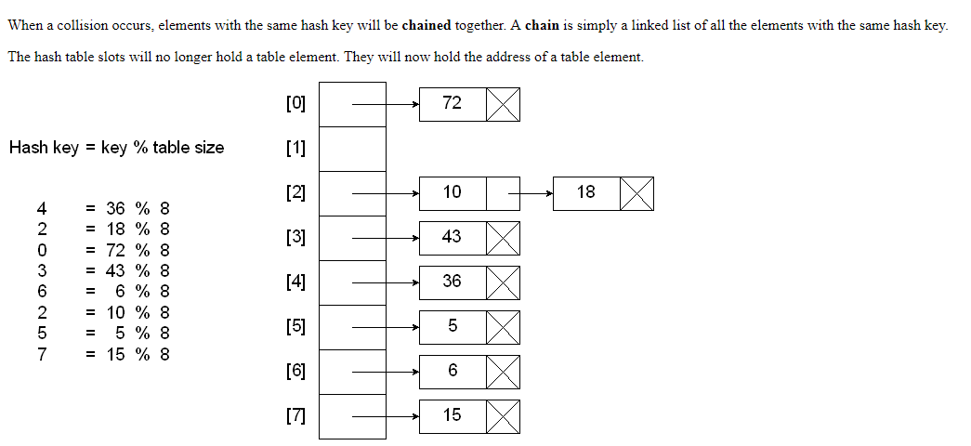
Hashing with Chains

Slide 15
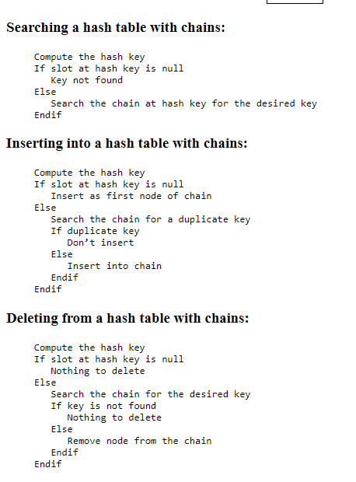

Slide 16
Hashing with Linear Probe
When using a linear probe, the item will be stored in the next available slot in the table, assuming that the table is not already full.
This is implemented via a linear search for an empty slot, from the point of collision. If the physical end of table is reached during the linear search, the search will wrap around to the beginning of the table and continue from there.
If an empty slot is not found before reaching the point of collision, the table is full.

Slide 17
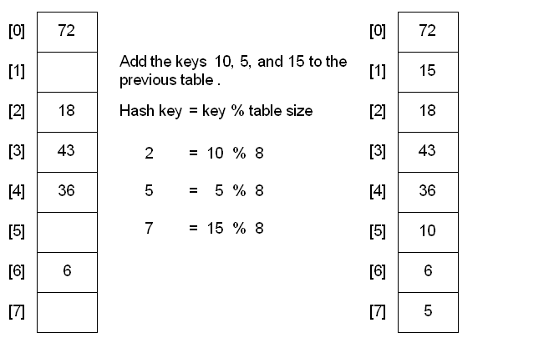

Slide 18
A problem with the linear probe method is that it is possible for blocks of data to form when collisions are resolved. This is known as primary clustering.
In linear probing, when a collision occurs, the algorithm checks the next slot sequentially (i.e., h(k) + 1, h(k) + 2, ...). Over time, this leads to contiguous blocks of occupied slots forming in the hash table.This phenomenon is called primary clustering:Once a cluster starts forming, new elements are more likely to join the same cluster rather than being distributed evenly.The cluster keeps growing, increasing the number of probes required for insertion and search.This degrades performance toward O(n) in the worst case.
For example, insert the nodes 89, 18, 49, 58, and 69 into a hash table that holds 10 items using the division method:

Slide 19
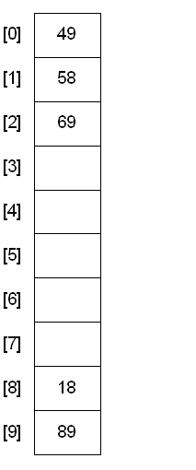

Slide 20
Hashing with Quadratic Probe
To resolve the primary clustering problem, quadratic probing can be used. With quadratic probing, rather than always moving one spot, move i² spots from the point of collision, where i is the number of attempts to resolve the collision.
h(k,i)=(h(k)+ i²)mod n

Slide 21
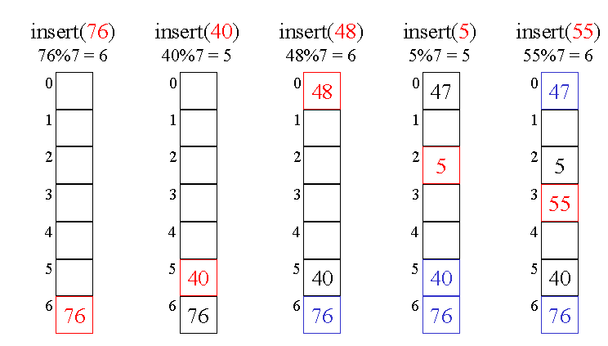

Slide 22
Limitation: at most half of the table can be used as alternative locations to resolve collisions.
This means that once the table is more than half full, it's difficult to find an empty spot. This new problem is known as secondary clustering because elements that hash to the same hash key will always probe the same alternative cells.

Slide 23
Hashing with Double Hashing
Double hashing uses the idea of applying a second hash function to the key when a collision occurs. The result of the second hash function will be the number of positions from the point of collision to insert.
A popular second hash function is: Hash₂(key) = R - ( key % R ) where R is a prime number that is smaller than the size of the table.

Slide 24
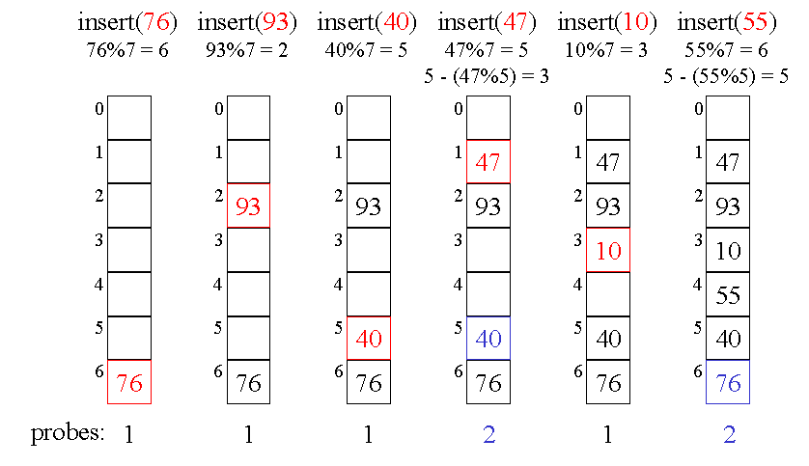

Slide 25
Questions
Consider the following insertion of element 5, 28, 19, 15, 20, 33, 12, 17, 10 into a chained hash table. The hash table has nine slots and function being h(k) = k mod 9.

